Slide 1
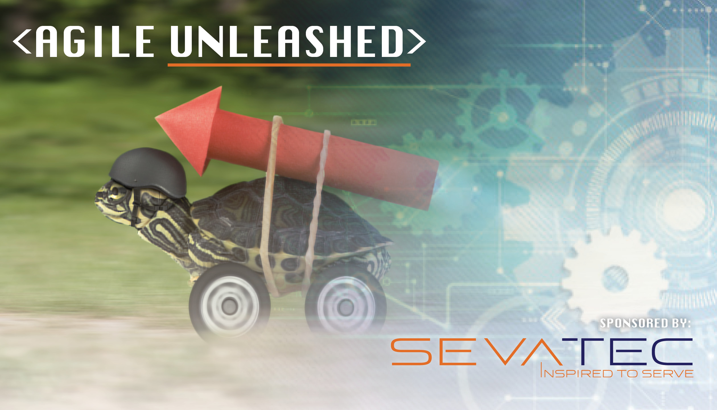
Agile FTW!
7/12/2018
Competitive Advantage and Happiness Through Business Agility

Slide 2
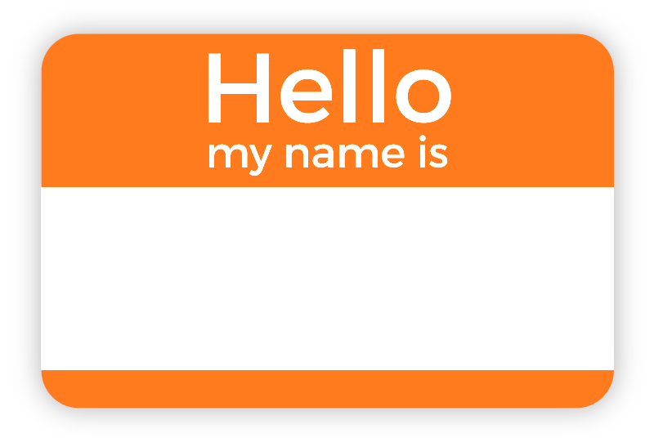
John Hughes
Organizational Agility Coach
Sevatec’s Agile Practice
Notes:
Objectives for the session:
The impact you can have on customer success and happiness when your company aligns to your client’s mission and their priorities
How Agile mindset and practices benefit Executive leadership and the corporate back-office as much as they do software delivery
Specific practices, tools, and integrations that can be used to enable Business Agility
How your company can begin to benefit too by applying what you learn from this presentation.

Slide 3
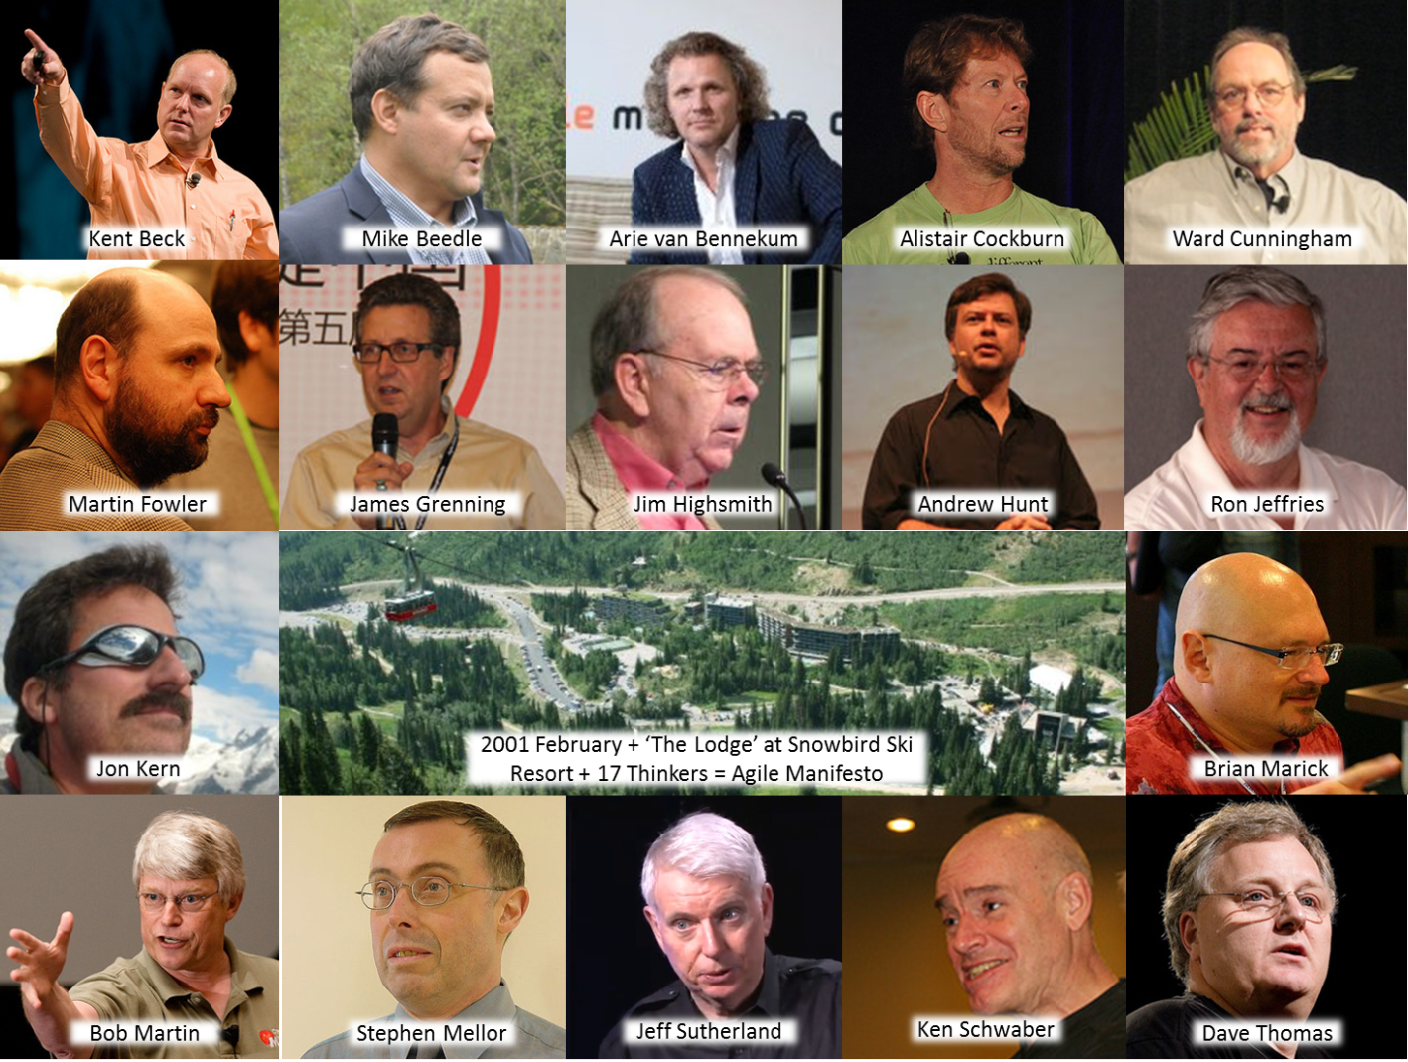
Agile – Created by Software People
Notes:
In February 2001, 17 Software guys met at the Snowbird resort in Utah to discuss lightweight development methods, energized around a better way to create software
They pulled from practices and ideas stemming back to TQM, Lean Manufacturing, and Toyota Production Systems as well as their own as a number of them had already created their own approaches, such as XP, Scrum, DSDM, and Crystal.
Their brainstorming led to a revolutionary set of ideas that were later published under the title: “Manifesto for Agile Software Development”

Slide 4
4 Values - Software Words
Individuals and Interactions
Over
Process and Tools
Working Software
Over
Comprehensive Documentation
Responding to Change
Over
Following a Plan
Customer Collaboration
Over
Contract Negotiation

Slide 5
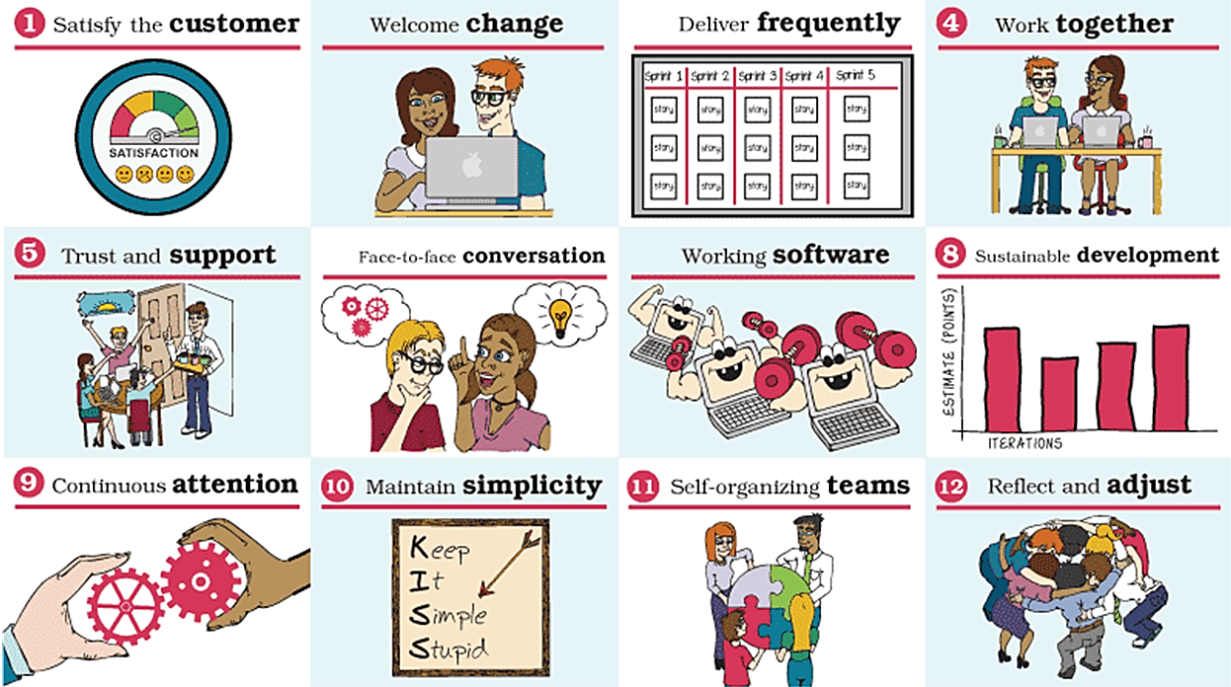

12 Principles – More Software Words
Be Agile?
Agile Mindset?
Practices? Tools?
Notes:
ASK: What does it mean to Be Agile, and have an Agile mindset
----Write down on flip chart
ASK: What are some examples of Agile practices and tools
----Write down on flip chart

Slide 6

Stop Thinking Agile is Just for Software

Slide 7

Bring It To The Business
Anyone do this already?
Examples of how?
Notes:
ASK: audience who already applies Agile outside of software, to the business side of the house
? A little
? Moderately
? Whole hog total Business Agility
These same values and principles, mindset, practices, and tools can be applied to business as well, not just Software.
Indeed, they can be applied to most every aspect of your life.
ASK: What examples can you share of how these values and principles may be applied in a business context

Slide 8
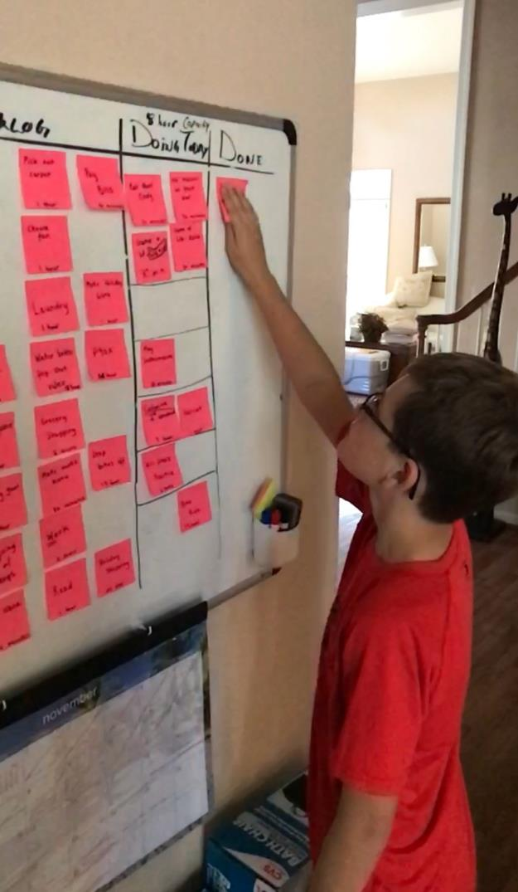
Even Your Home!
…but let’s just focus on the business for this session

Slide 9

Crossing That Bridge
A value-driven, data-driven focus
Frequent touchpoints and collaboration
Visibility, transparency, and awareness
Cross-functional mission-aligned teams
Agile roles to enable the right behaviors
Fast feedback and continuous improvement
Agile Mindset
Corporate DevOps

Slide 10

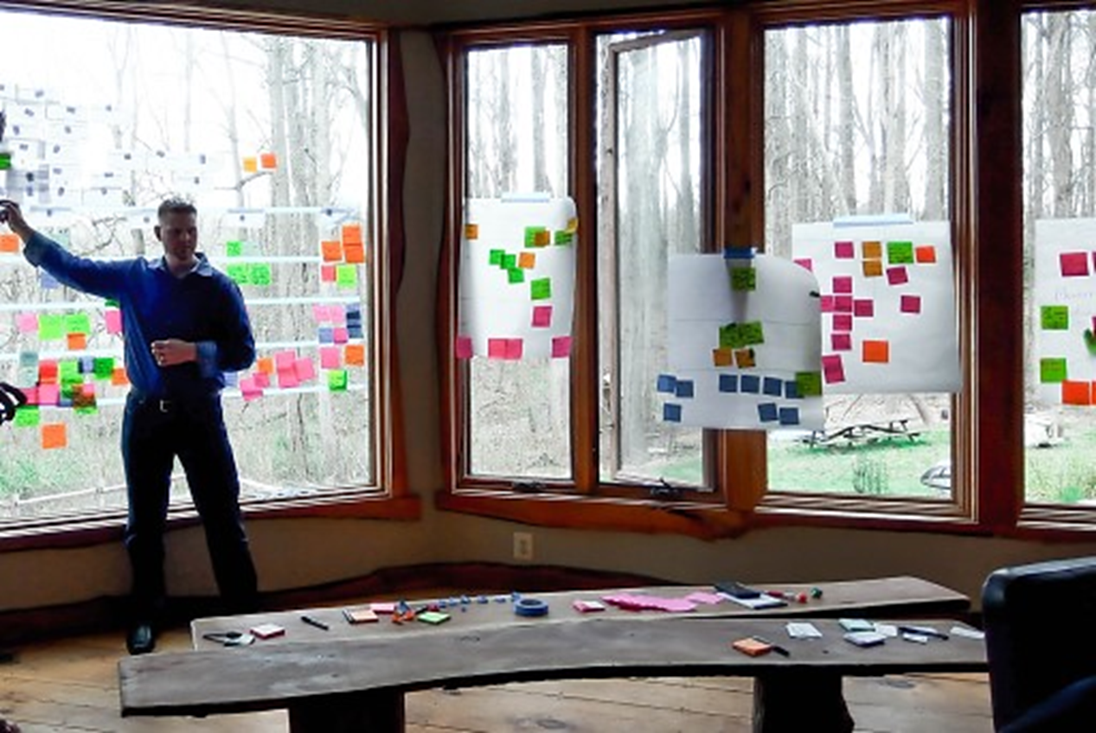
Corporate Strategic Planning Initiative
Agile
Storytime
Notes:
Tell the story of our corporate Strategic Planning to show how Business Agility was incorporated into that process
I was focused mostly on coaching programs, setting up our Agile practice, and writing proposals when we hired a Strategic Planner - Bill - to work with us and help us draft a Strategic Plan as our company had graduated from small business and was now moving firmly into full-and-open competition as a medium-sized business
I had recently shared some ideas about bringing Agile to our Mission Support Office (MSO) and started a basic experiment of Agile practices across teams such as Contracts, HR, and Finance
I was interviewed by the Bill who liked what I had to say and began including me in more of his work
I shared my MSO-Agile work with him and told him about my ideas for including Agile into more of the business areas, and they aligned with his thoughts as well. He took the idea of increasing our use of Agile practices on the business-side back to the executives and piqued their interests.

Slide 11
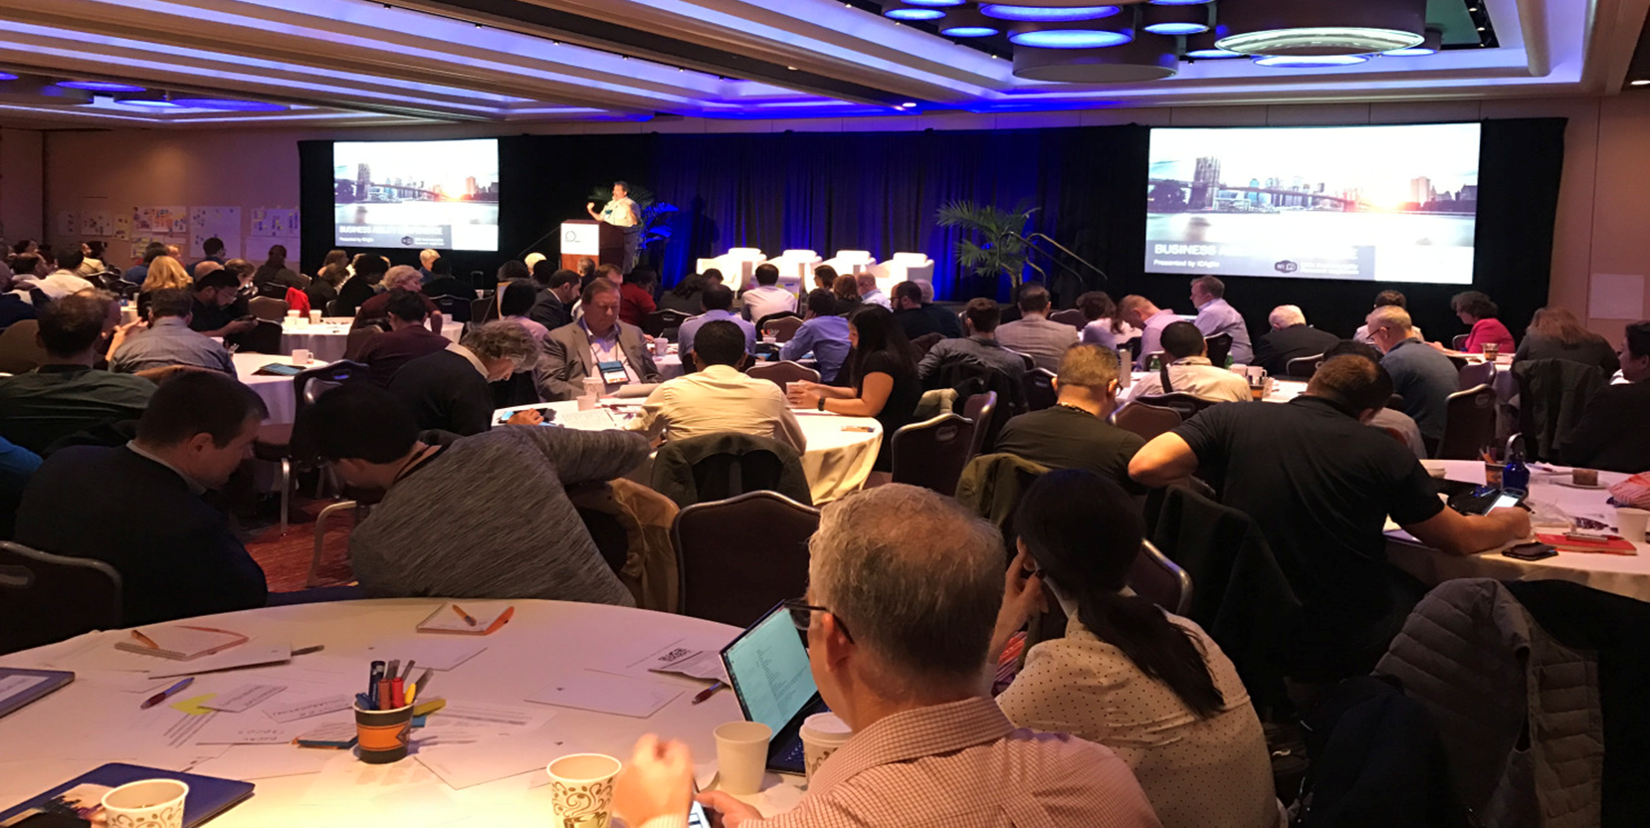
Top Down Champions – BACon 2017
Notes:
I sat with the execs and shared my thoughts about Agile and Business Agility and along with Bill, got them excited to attend the inaugural Business Agility conference in NYC that February.
CEO (Sonny), COO (Mike), CS (Bill), and myself attended
Great presentations by corporate execs practicing Agile and leading through SDi Teal practices were a big eye opener and very inspiring
Decided to move the company to Agile through Business Agility and total Agile delivery
Decided to make Agile a big part of our Strategic Plan
Plan it in an Agile way
Get us to the point of Being Agile
Aligning practices and behaviors to the Agile values and principles
Developing a culture that reaps the benefits of agility
Striving for the happiness promised through Agile outcomes

Slide 12
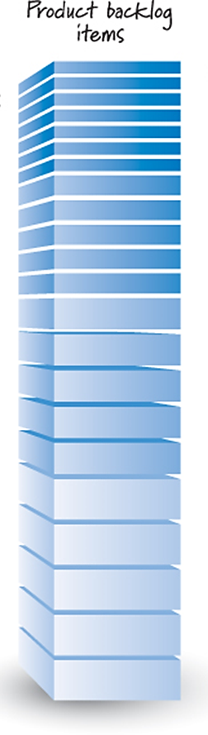

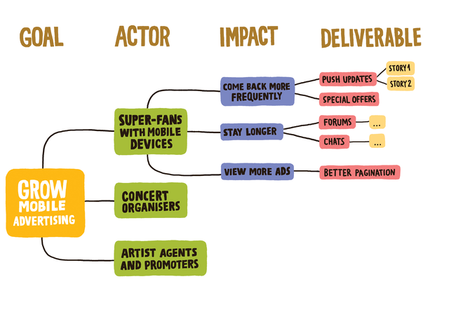
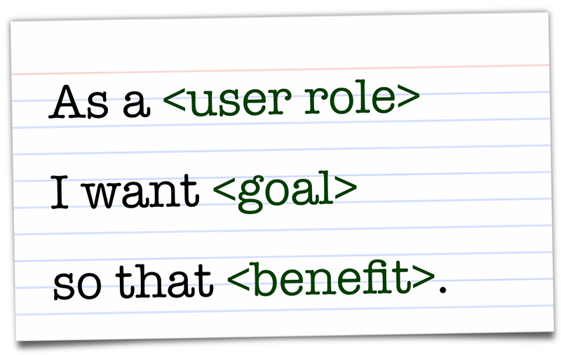
Shaping Ideas Into Value-aligned Initiatives
Impact Map
Notes:
The practices and tools we used to plan and execute the Strategic Planning effort to create the Strategic Roadmap
Bill created a PowerPoint with thoughts for the Strategy including his ideas for goals, objectives, direction, initiatives, and a consideration for the number of years to target the major outcomes
I took Bill’s PowerPoint and created an Impact map from it as an initial seed
We would eventually use this to further prioritize goals, discover initiatives and activities needed, and people involved (groom roadmap)
Would eventually use this to shape discussions about prioritization of initiatives given the amount of impact we believed they would make against the main goals (groom backlog)
I then took the Impact map and created a Backlog of Epics (Initiatives) from the threads pulled across it
Our CEO – Sonny – and Bill planned an offsite for our corporate leadership to focus on communicating the Strategic plan and gaining their participating in building out our Impact map and Backlog.

Slide 13
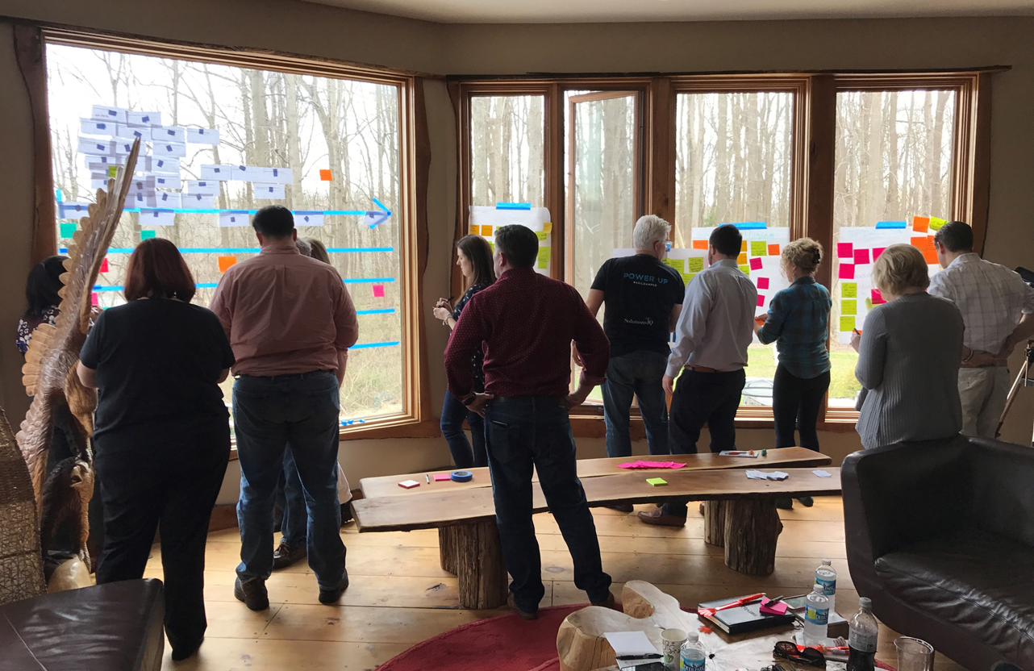
Strategic Planning Offsite
Notes:
Strategic Planning Offsite
Sonny and Bill communicated the Strategic Planning effort and we ran a series of workshops to introduce topics and educate our leaders on them
I hosted a session to educate the leaders on Business Agility
What it was and how it applied to us a Sevatec
What an initial rollout of Business Agility could look like
Focus on rolling out practices and behaviors for
Value-driven
Data-driven
Experimentation-mindset
Focus on creating happiness and delivering success
Explained to them why it was important to adopt Business Agility…
To ensure Sevatec has a strong future ahead; winning business; growing at margin; attracting top talent and exciting them to stay so we may deliver excellence for ourselves and our clients
Improve performance; Increases value; Further Separates Sevatec from the Status Quo
Roadmapping workshop
<Picture of backlog grooming on windows>
Put notecards with the groomed backlog initiative up on a set of windows in Sonny’s house
Created a timeline across the windows
The whole leadership team ordered the initiatives using Affinity mapping to eventually create our Strategic Roadmap over the next 3 years.

Slide 14
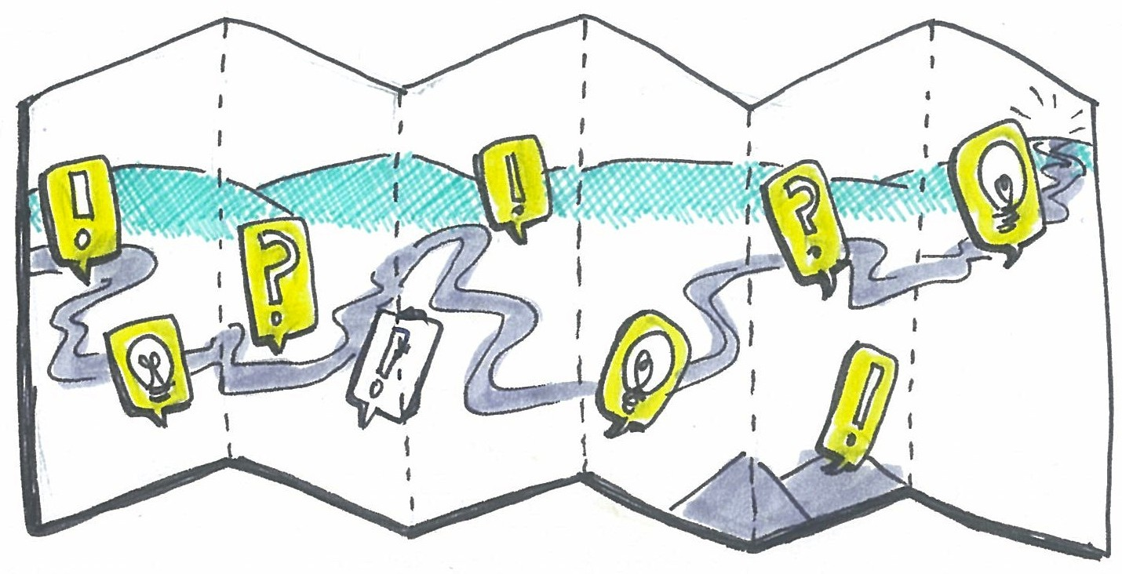
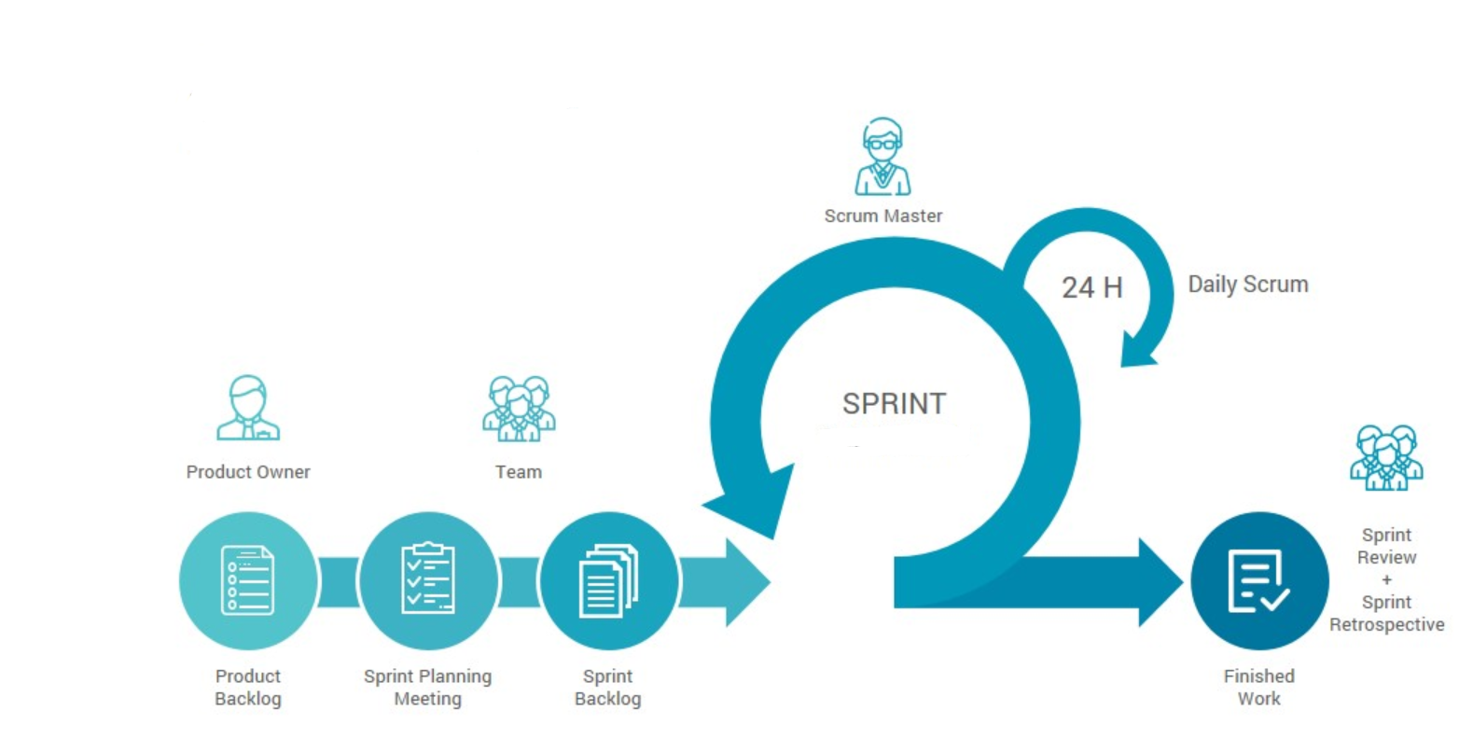
Execute on the Strategic Plan
Goals, Initiatives, Activities in Jira
Ordered Strategic Backlog
Strategic Roadmap showing 3 years
Strategic Plan Scrum board
Scrum-like Agile practice using Iterations
Planning
Standups/Touchpoints
Burndowns
Review
Retrospective
Notes:
What practices and tools we used to communicate and execute on the Strategic Plan
After the off-site…
I created a customer “Goal” issue type in Jira and loaded our Corporate Goals
I loaded all of the Initiatives into Jira to form our Strategic Backlog and ordered them according to our Affinity mapping exercise
I created a Strategic Roadmap Board to ensure visibility to all and set up the statuses to allow the Strategic Backlog to show across that Roadmap board spanning three years
I ensured the Roadmap and Strategic Backlog were openly visible in Jira
I finished the Jira work up by creating a Scrum board in Jira so we could watch our Strategic Sprint activities move across the boards, and view our Burndowns during the Sprints we would soon kick-off
How we communicated to the company…
Groomed the Backlog to create the Activities (User Stories) for the Initiates (Epics) that we would pull into the first quarter
Loaded Jira with the User Stories for the Quarter
Held our first Planning meeting to “commit” to a set of Stories
[graphic of Goal-to-activity alignment]
Showed how all the activities aligned to the top goals
Showed the prioritized Initiatives and noted that some of the Initiatives required shared effort between the offices
Execs each committed to a set of Stories that their offices would complete that Quarter
Standups/Touchpoints, Integrated working sessions where Activities aligned to shared Initiatives
Burndowns
Review
Retrospective

Slide 15
Benefits and Outcomes
Modern Leadership
“Let’s go completely Agile!”
Cross-Functional Touchpoints
Ops Mesh
Agile Quality Management
Contract Retros
BD Mesh
Notes:
What benefits we saw from strategic planning and execution in an Agile way
Decision to run the company in an Agile way, through modern leadership practices, and to bring agility to the whole company
Cross-functional “meshes” to add more frequent touchpoints and mission-aligned collaboration
Series of Ops Meshes and other cross-functional Ops-focused touchpoints at differing intervals
BD Meshes
Agile Quality Management

Slide 16




Connecting the Company
Goal
Strategic Initiative
Strategic Activity
Epics
Value-driven Acceleration
All work can tie back to the highest priority Strategic Goals and Initiatives
Stories
Sub-Tasks
Notes:
How this extends to greater Business Agility throughout the company
The company’s focus extends from the Strategic goals and the Activities committed to during the Quarter by each officer

Slide 17
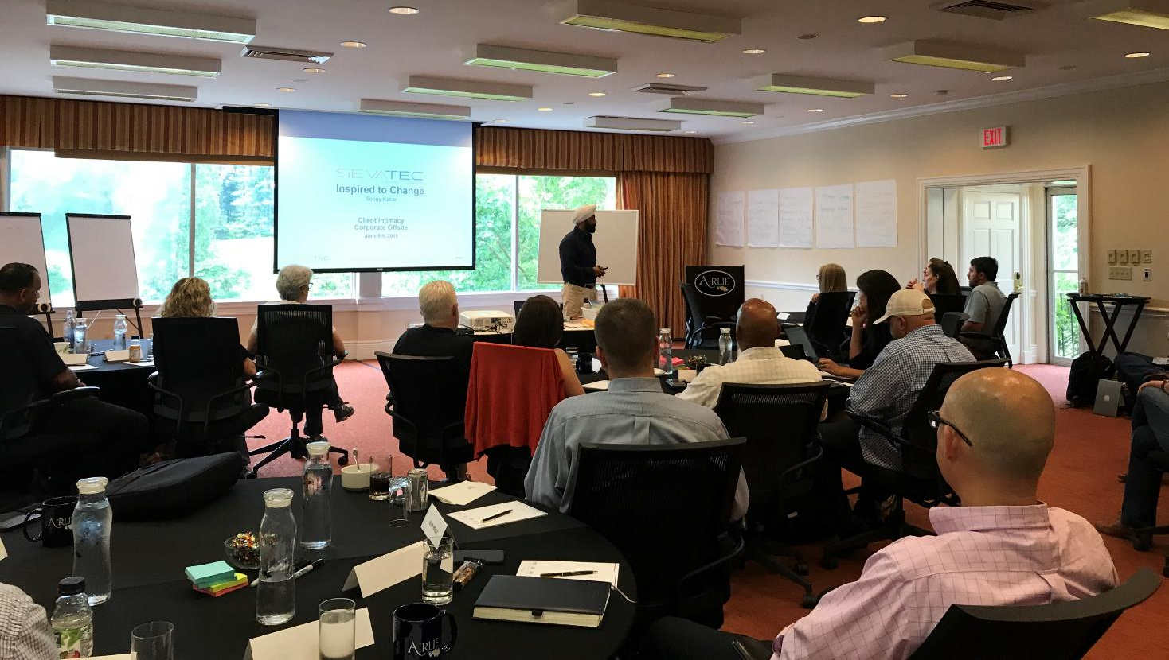
Round 2: Customer Intimacy and Psychological Safety
Notes:
Adding a company-wide focus on Customer Intimacy and psychological safety to deliver customer success and have extraordinarily happy customers
The following year, held the next offsite as a follow-up with the top 30 leaders of the company to extend additional maturity given the year’s focus on agility
Customer Intimacy
Psychological Safety
Customer Intimacy and the CI Ecosystem
Ready to graduate beyond “what will drive success for Sevatec” to “what will deliver success to our customers”
Understanding that empathy, curiosity, and awareness to the customer’s organization and priorities allow us to partner with them to deliver what actually creates success for them
Change our behaviors and mindset in this way to focus on creating extraordinarily happy customers
Psychological Safety
Creating an environment of openness and safety such that everyone is comfortable speaking their full truth
More accurate status and ground truth
More ability to deal with the reality of the situation and make decisions that actually help move the needle
A safe environment allows greater employ and customer happiness
Additionally, helps with employee retention and corporate recruiting once the culture has truly transformed to provide safety, openness, and wholeness.

Slide 18
Let’s Talk A Bit More About the Practices and Behaviors Themselves
Seeing Agile from the Business Lens

Slide 19

Value-driven Focus
Goal
Impact maps
Value stream maps
Roadmaps
Backlogs
Epics/User Stories
OKRs (Objectives and Key Results) and
CFRs (Conversations, Feedback and Recognition)
Strategic Initiative
Strategic Activity
OKR/CFR
Notes:
(10 mins) Value-driven focus on the most important goals, objectives, and initiatives
Impact maps
Value stream maps
Roadmaps
Backlogs
Epics/User Stories
OKRs (Objectives and Key Results) and CFRs (Conversations, Feedback and Recognition)

Slide 20
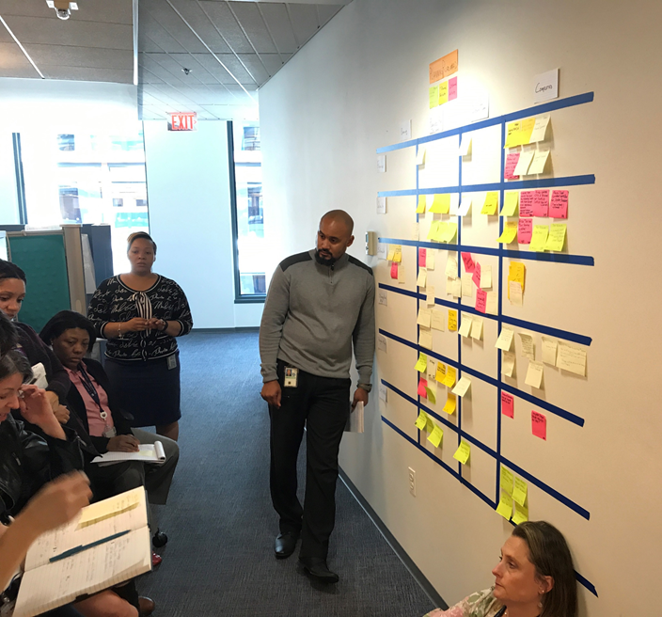
Frequent Touchpoints and Collaboration
Roadmap and Backlog Grooming
Iteration Planning and Review
Daily Standups
Program Increment Planning and Reviews
Scrum of Scrums
Cross-functional “meshes”
Notes:
Frequent touchpoints and collaboration
Roadmap and Backlog Grooming
Iteration Planning and Review
Daily Standups
Program Increment Planning and Reviews
Scrum of Scrums
Cross-functional “meshes”

Slide 21
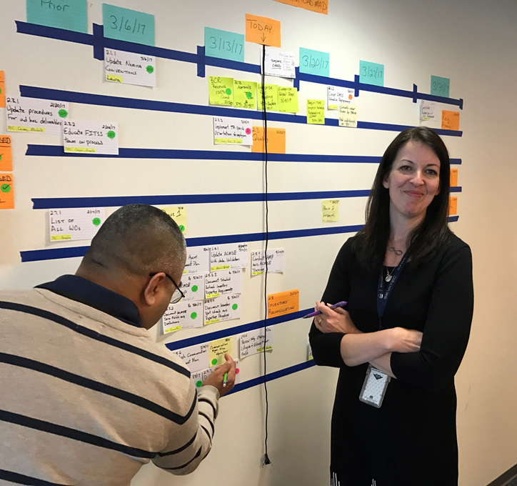
Visibility, Transparency, and Awareness
Kanban Boards
ALM tools like Jira or TFS
Chat tools like Slack or MS Teams
Notes:
Visibility, transparency, and awareness
Kanban Boards – Physical and Electronic
ALM tools like Jira or TFS
Chat tools like Slack, MS Teams

Slide 22
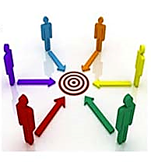
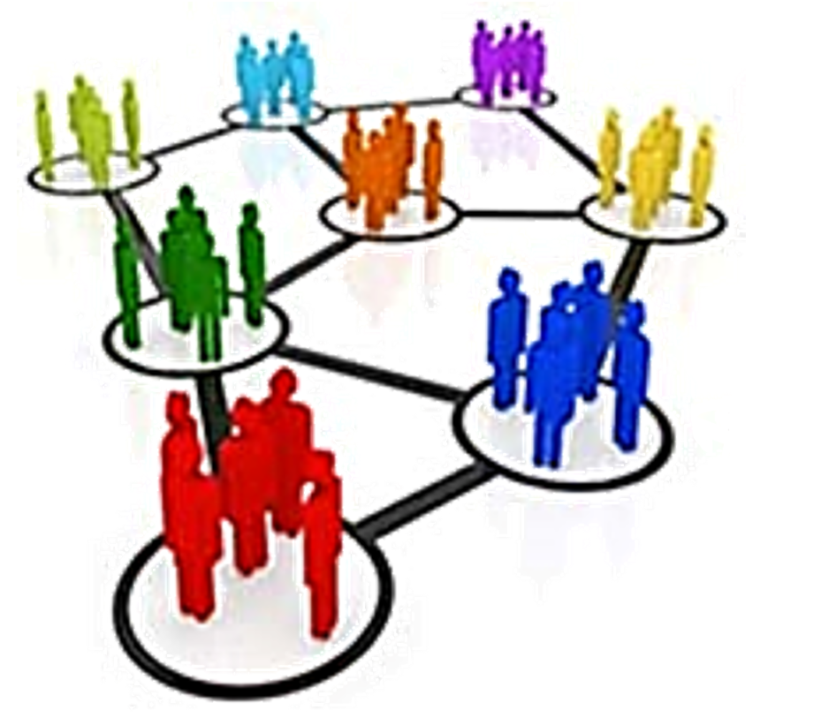
Cross-Functional Mission Aligned Teams
Functional Silos,
Lack of Communication,
Multiple Handoffs
Cross-Functional Roles,
High Collaboration,
Results Oriented
Notes:
Cross-functional teams/mission aligned
“Agile team” - Vertical slice of all functional areas required to deliver customer success
Team Chartering
Working agreements
Definition of Done

Slide 23
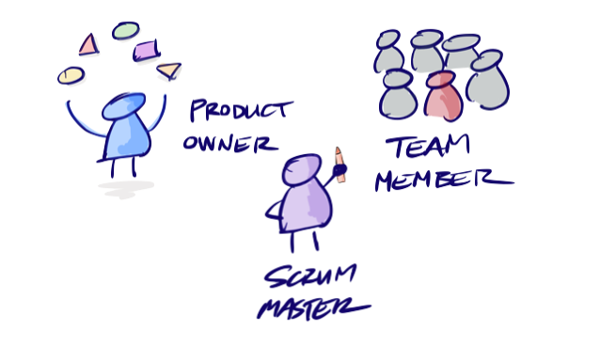
Agile Roles to Enable the Right Behaviors
Product Owner Team / Value Team
Product Owners
ScrumMasters
Agile Team members
Notes:
Agile roles to enable the right behaviors
Product Owner Team / Value Team
Product Owners
ScrumMasters

Slide 24
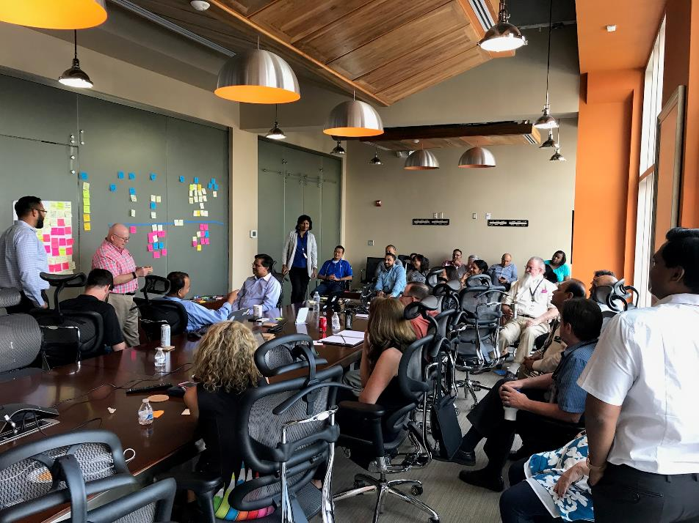
Fast Feedback and Continuous Improvement
Retrospectives
Cross-functional with customers
Internal after iterations
After business milestones
After issues arise
Surveys
Conversations
Notes:
Fast Feedback and Continuous Improvement
Retrospectives
Cross-functional with customers
Internal after iterations
After business milestones
After issues arise

Slide 25
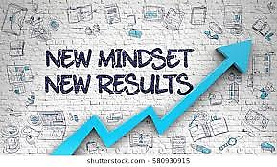
Mindset
Culture of transparency and awareness
Openness and Psychological safety
Empowerment and self-management
Happy customer and happy employees
Wholeness
Notes:
Mindset
Culture of transparency and awareness
Openness and Psychological safety
A safe and caring workplace
Empowerment and self-management
Happy customer and happy employees
Wholeness

Slide 26

“Corporate DevOps” - Mindset
All functional areas working from the beginning of an effort
e.g. Proposals, Capture, and Recruiting…
Shared ownership, not “throwing it over the wall”
Notes:
DevOps mindset – all functional areas working from the beginning of an effort
For example, proposals and capture… wouldn’t it be great to have your recruiters working up front with your BD and Finance folks so that we go after deals we can staff, and price realistically to who we can recruit
not “throwing it over the wall” (corp back office doesn’t wash its hands of a program once it’s in delivery phase; the delivery team is responsible for coping with the early choices made which could include a bad staffing mix, terrible pricing, or weird promises to customer).

Slide 27
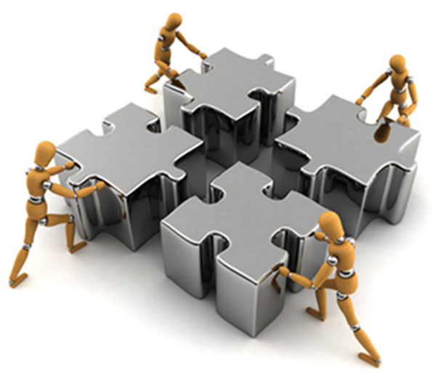
“Corporate DevOps” – Technology Practices
Integrate back-office tools to gain efficiencies
Leaning out processes through automation
Predictive analytics
Monitoring and notifications
Notes:
DevOps technology practices
Integrate back-office tools to gain efficiencies, and for a more comprehensive look at data, and predictive analytics – risks, quality, compliance
Leaning out processes through automation, shifting left, and integration

Slide 28
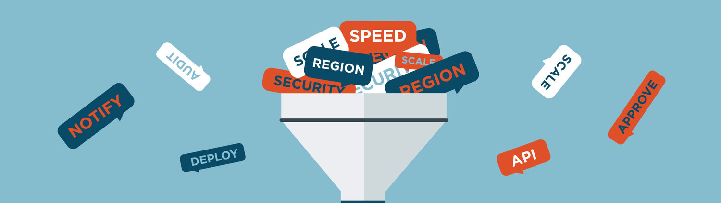
“Corporate DevOps” - ChatOps
Tools like Slack and MS Teams bring everything together in a very consumable, centralized way
Notes:
ChatOps is a great enabler
Tools like Slack and MS Teams bring everything together in a very consumable, centralized way

Slide 29
Business Agility Benefits
Benefits of applying Agile and DevOps mindset and practices to the business
Revenue and growth accelerate
Corporate processes lean out
Employees are more capable
Real-time awareness and predictive analytics
increased effective decision-making and empowerment
Employees are happier. Customers are happier. The corporate bottom-line reflects this happiness.
Notes:
Benefits of applying Agile and DevOps mindset and practices to the business
Revenue and growth accelerate as we focus the company’s assets on delivering in the most valuable way
Corporate processes lean out as we remove wasteful bottlenecks, saving money, time, and providing competitive advantage
Employees are more capable as corporate practices are more meaningful and less taxing
Back-office tools and data are integrated into a unified experience allowing real-time awareness and predictive analytics, increasing effective decision-making and enabling empowerment at lower levels
Employees are happier. Customers are happier. The corporate bottom-line reflects this happiness.

Slide 30
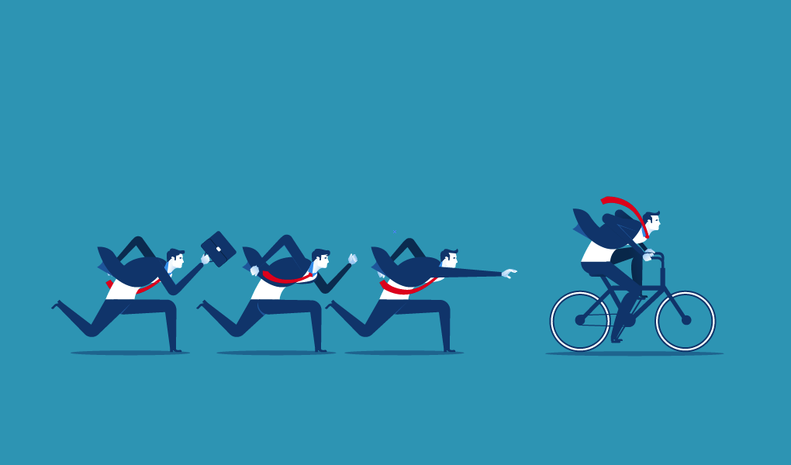




Wrapping it Up
Notes:
Any wrap up to tie back to the beginning slide of values and principles, etc.

Slide 31

Questions? Discussion?
?
?
?
?
?
?
?
?
?
?
?
?
?

